Slide 1
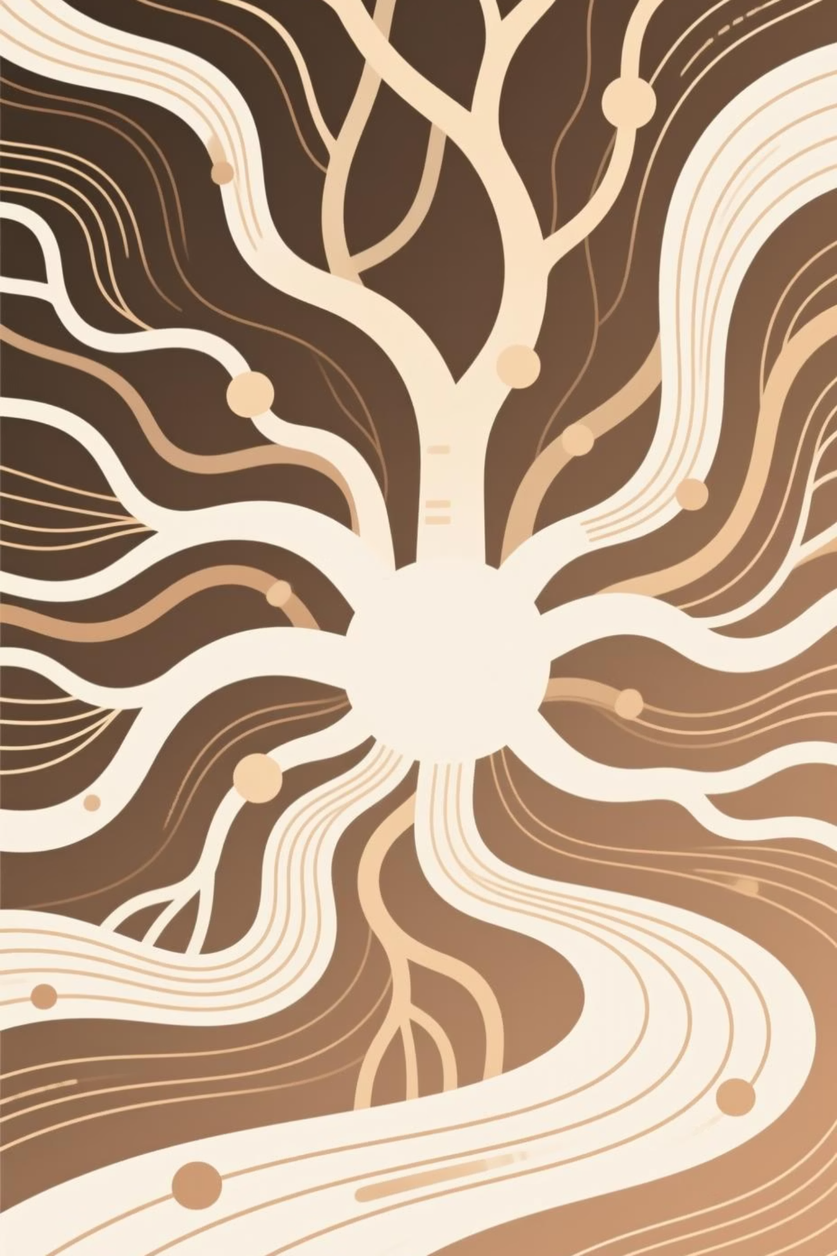
How Modern AI Actually Works
A clear, intuitive guide to understanding machine learning, neural networks, and language models—no math required.

Slide 2
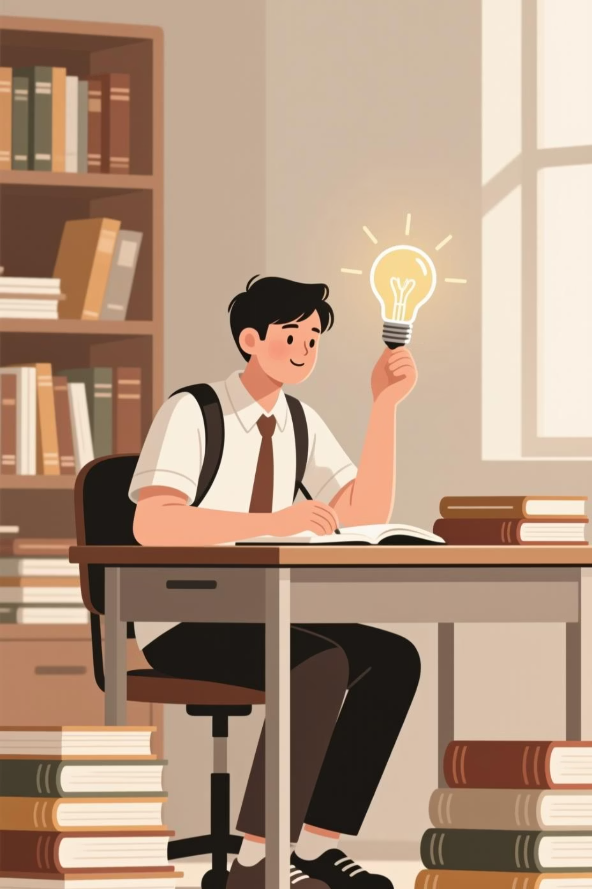
What Is Machine Learning?
Machine Learning is a branch of AI where computers learn from examples rather than following hand-coded rules. Instead of programming every scenario, we show the system thousands of examples and let it discover patterns.
01
02
Data Collection
Pattern Recognition
Images, text, audio, numbers—any information the system can process and learn from.
The model studies examples to identify relationships, trends, and correlations in the data.
03
Predictions
Using discovered patterns, the system makes intelligent guesses or generates new outputs.
Think of ML like a student mastering multiplication tables: after seeing enough examples, they can solve problems they've never encountered before.

Slide 3

Machine Learning in Daily Life
Email Filtering
Recommendations
Medical Diagnosis
Systems learn what counts as spam by studying millions of examples, protecting your inbox automatically.
Platforms learn your preferences from viewing history, suggesting content tailored to your tastes.
AI detects tumors and diseases by learning from thousands of medical imaging examples.
Key Misconception: ML doesn't "understand" like humans—it identifies statistical patterns in data. The system recognizes correlations without comprehending meaning.

Slide 4




Neural Networks: The Brain-Inspired Engine
Neural networks are ML systems loosely inspired by the brain, consisting of layers of virtual "neurons." Each neuron performs small mathematical operations that, combined across layers, can detect incredibly complex patterns.
Input Layer
Data enters: image pixels, words in a sentence, or numerical values.
Hidden Layers
Each neuron transforms data, finding patterns step by step through the network.
Output Layer
Produces a final result: "dog," "next word: sun," or a category classification.
Imagine a series of photo filters: each layer sharpens or adjusts the image until the final picture becomes crystal clear. Neural networks refine data the same way.

Slide 5

Why Neural Networks Are Powerful
Pattern Detection
Deep Learning
Neural networks identify patterns too complex for humans to explicitly program or even recognize.
Deeper networks with more layers build complexity through many small transformations, handling sophisticated tasks.
Versatile Applications
From image recognition to voice transcription to language understanding—one architecture, endless possibilities.
Think About This
Answer: Each layer builds on the previous one, creating increasingly sophisticated representations. Early layers might detect edges in images, middle layers recognize shapes, and deep layers identify complete objects.
Why do deeper networks—those with more layers—learn more complex patterns?

Slide 6

Language Models: Predicting the Next Word
A language model is AI trained to predict the next word in a sentence. This seemingly simple task unlocks remarkable capabilities when performed at massive scale.
1
Massive Reading
The model reads billions of words from books, websites, and educational content.
2
Pattern Learning
It learns how words and sentences typically follow each other in human language.
3
Statistical Mapping
The system builds a complex statistical map of language relationships and context.
Predicting the next word is like playing an infinite game of "Guess the next word in a story." After billions of rounds, the model becomes extraordinarily skilled.

Slide 7


How Language Models Mimic Understanding
The Prediction Example
Prompt: "The Eiffel Tower is located in…"
Prediction: "…Paris."
The model doesn't know Paris exists. It has simply seen this pattern thousands of times in training data.
Grammar & Context
Factual Patterns
Style Mimicry
Recognizes proper sentence structure and maintains contextual coherence across paragraphs.
Recalls information patterns embedded in training text, appearing knowledgeable.
Adapts tone, formality, and writing style based on learned examples.

Slide 8
Capabilities from Next-Word Prediction
Remarkably, the simple mechanism of predicting the next word enables a stunning array of sophisticated capabilities.
Summarization
Translation
Condensing long texts by predicting which key points typically follow "In summary..."
Generating equivalent expressions in different languages based on multilingual training.
Conversation
Creative Writing
Responding naturally by predicting appropriate conversational replies.
Generating stories, poems, or essays by extending patterns in creative text.
Coding
Analysis
Writing software by predicting syntax and logic patterns from programming examples.
Identifying patterns, trends, and relationships across different types of text.

Slide 9


Activity: Ask the AI
Your Challenge
Ask an AI assistant: "Explain how you work in 3 sentences."
01
Read Carefully
Study the AI's response with fresh eyes.
Debrief Questions
02
Did the AI describe itself clearly?
Compare Concepts
What did it explain accurately?
What did it leave out—prediction mechanics, layers, or training data?
Match it against ML, neural networks, and language models.
Does understanding the explanation change your perspective?
03
Critical Analysis
Find one thing explained well and one oversimplification.
Goal: Recognize the difference between AI's appearance of understanding and the underlying statistical mechanics actually at work.

Slide 10
Key Takeaways
Learning from Examples
Layered Transformation
Prediction as Foundation
AI systems learn from data and examples, not instincts or preprogrammed knowledge.
Neural networks use multiple layers to progressively transform data into insights.
Language models rely on next-word prediction as their core mechanism for all capabilities.
Pattern Recognition
Effective Collaboration
AI's abilities emerge from statistical patterns, not human-style thinking or consciousness.
Clear prompting combined with understanding AI mechanics leads to better results.
What's Next: Now that we understand how AI works, let's explore where it already appears in our daily lives—often without us even noticing.

